Slide 1
Breast cancer
Supervised by prof. Ahmed Said Eltarass
Graduation project 2022

Slide 2
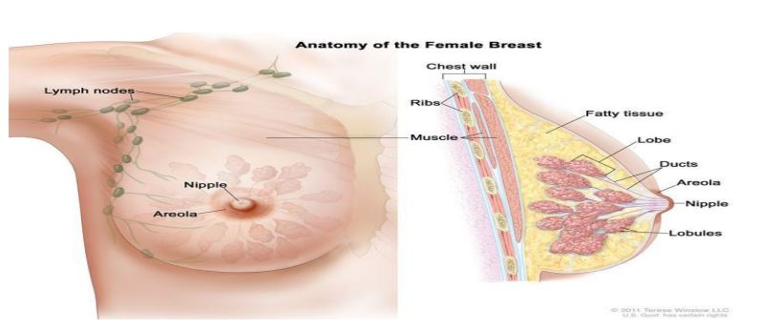
Breast cancer is the most common type of cancer in women and considered to be a leading cause of death among middle-aged and old women, especially in western countries. In Egypt, breast cancer is the most common type of cancer among females. Successful early detection and characterization of breast cancer can enhance the available options for treatment, and increase the rate of patients’ survivability.

Slide 3
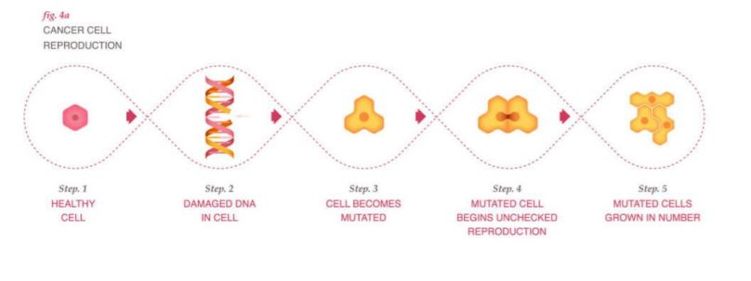
what is cancer?
Cells are the basic units that make up the human body. Cells grow and divide to make new cells as the body needs them. Usually, cells die when they get too old or damaged. Then, new cells take their place.
Cancer grows when a cell’s DNA is damaged

Slide 4
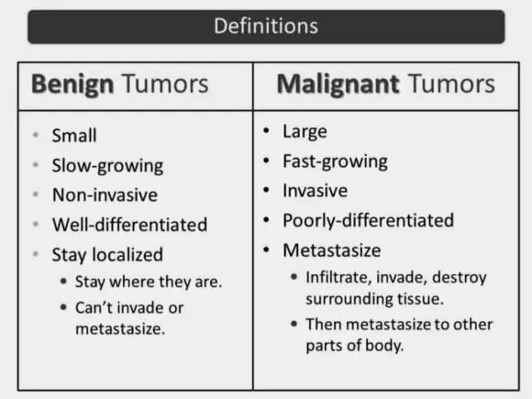
Tumors
Cells start to grow uncontrollably. These cells may form a mass called a tumor. A tumor can be :
1- malignant 2- benign.
A cancerous tumor is malignant: meaning it can grow and spread to other parts of the body
A benign tumor : means the tumor can grow but will not spread.

Slide 5
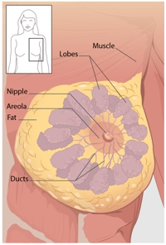
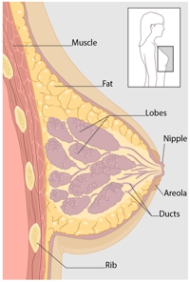
What Is Breast Cancer?
Breast cancer is a disease in which cells in the breast grow out of control. There are different kinds of breast cancer. The kind of breast cancer depends on which cells in the breast turn into cancer.
Breast cancer can begin in different parts of the breast. A breast is made up of three main parts: lobules, ducts, and connective tissue. The lobules are the glands that produce milk. The ducts are tubes that carry milk to the nipple. The connective tissue (which consists of fibrous and fatty tissue) surrounds and holds everything together. Most breast cancers begin in the ducts or lobules.
Breast cancer can spread outside the breast through blood vessels and lymph vessels. When breast cancer spreads to other parts of the body, it is said to have metastasized.

Slide 6
Tests that examine the breasts are used to diagnose breast cancer :
• Mammogram: An x-ray of the breast.
• Ultrasound exam: A procedure in which high-energy sound waves (ultrasound) are bounced off internal tissues or organs and make echoes. The echoes form a picture of body tissues called a sonogram. The picture can be printed to be looked at later.
• MRI (magnetic resonance imaging): A procedure that uses a magnet, radio waves, and a computer to make a series of detailed pictures of both breasts. This procedure is also called nuclear magnetic resonance imaging (NMRI).
• Blood chemistry studies: A procedure in which a blood sample is checked to measure the amounts of certain substances released into the blood by organs and tissues in the body. An unusual (higher or lower than normal) amount of a substance can be a sign of disease.
• Biopsy: The removal of cells or tissues so they can be viewed under a microscope by a pathologist to check for signs of cancer. If a lump in the breast is found, a biopsy may be done.

Slide 7
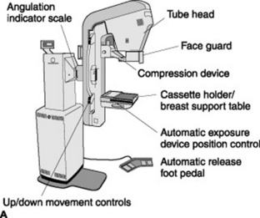
Mammography
A mammogram is a 2D image that help to identify suspicious findings

Slide 8
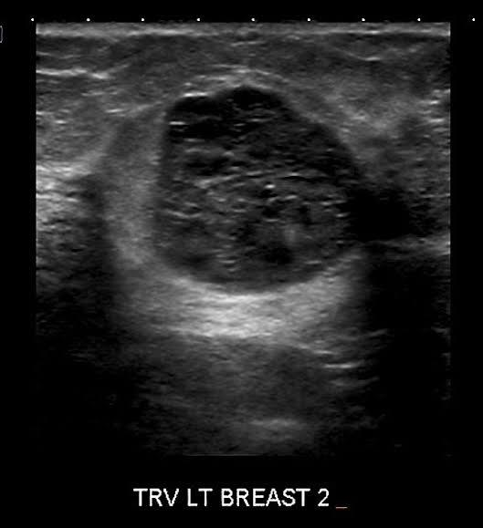
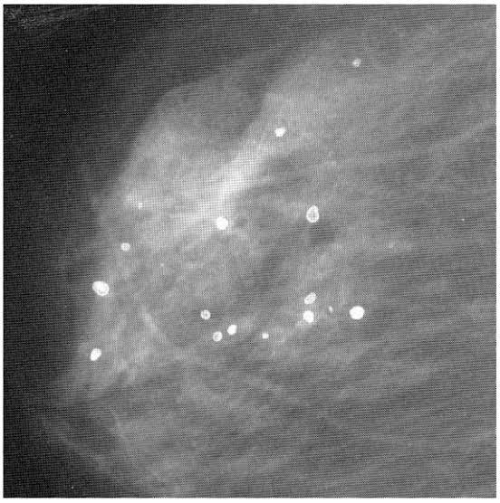
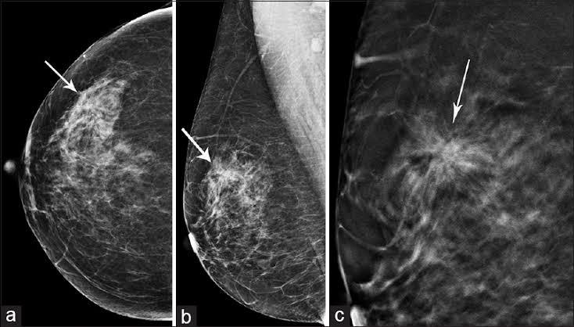
Abnormalities in mammograms
Mass lesions: they have high ,medium or low density compared to normal fibro-glandular tissue
Micro Calcification: they are small calcium deposits
Architectural Distortion: Their appearance increase suspicions that the patient may have breast cancer

Slide 9
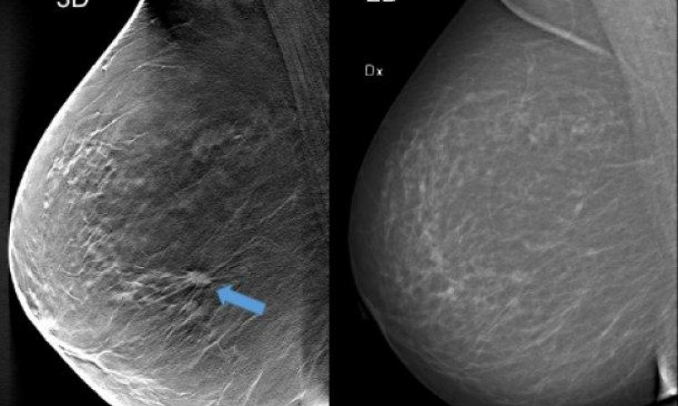
How to use mammogram
1- breast tissue is pressed by a plat
2- penetrate low energy (20-32 kVp) X-ray
3- radio graphic image is produced

Slide 10
Pros & Cons of mammograms
Advantages:
1- since introduction of mammography 30 years ago this has improved breast imaging
2- this methods has reduced mortality rate by about 20%-40%
Disadvantages:
1- restricted to detection in dense breast tissue
2- have high false positives due to overlap of fibro-glandular tissue in 2D imaging
3- inducing radiation in breast tissues can cause cancer
4- sensitivity decrease with density of breast

Slide 11
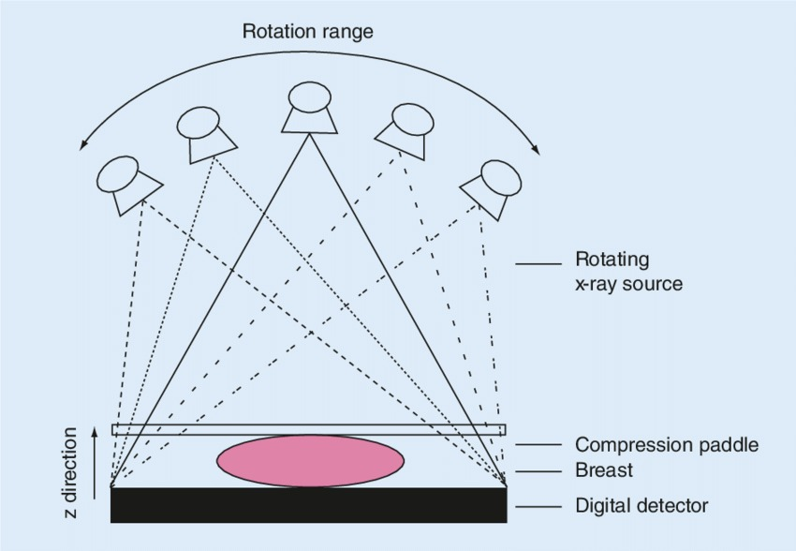
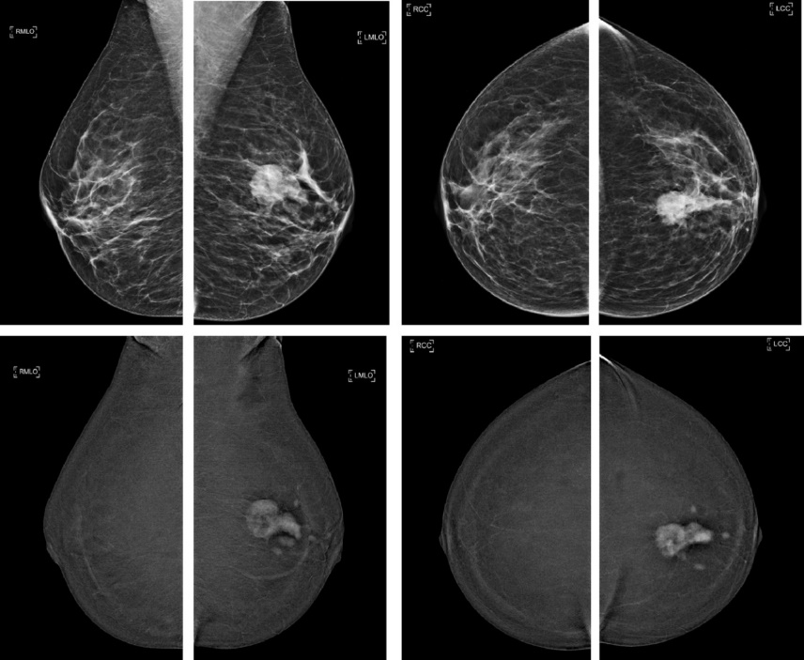
Due to disadvantages of mammography new technologies has been introduced:
Tomo-synthetic technologies:
Contrast enhanced imagery:
Digital breast tomography (DBT)
Contrast enhanced digital mammography (CEDM)

